Slide 1


Simulation of laboratory-scale free fall cone penetrometer test with material point method
Debasis Mohapatra, Wojciech T. Solowski
Aalto University, Espoo, Finland
Maarit Saresma, Joonas Virtasalo
Geological Survey of Finland, Espoo, Finland

Slide 2
Contents
1. Background or need of the study
Experimental investigation of laboratory scale free fall cone penetrometer test on Marine clay
Numerical simulation of free fall cone penetrometer test on Marine clay using MPM
Introduction to MPM
Strain rate Effect
Strain softening effect
4. Conclusions and Outlook for future

Slide 3
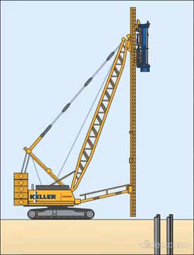
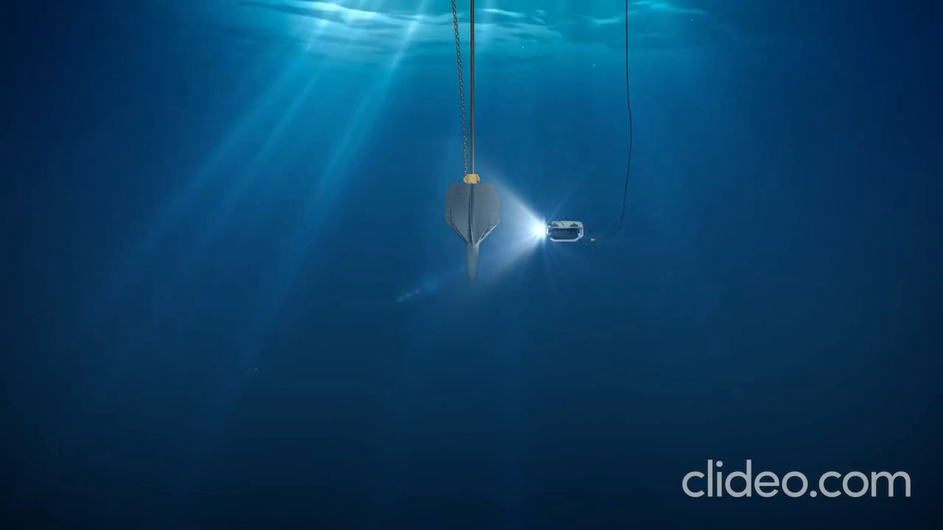
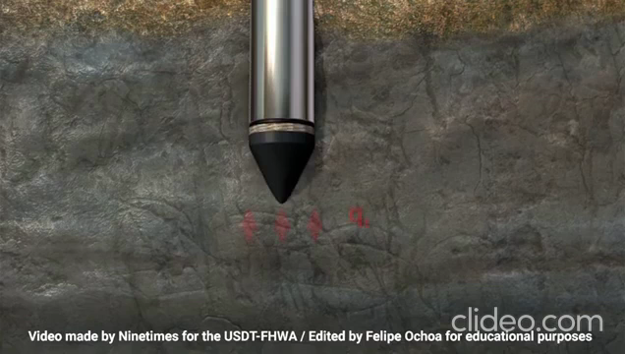
Dynamic penetration problems in Geotechnical Engineering
© Keller Group
Pile Driving
© RCAM Technologies
Installation of Torpedo Anchors
©https://www.youtube.com/watch?v=98Q9Huc9Us0
Measurement of soil properties
Notes:
Numerical and experimental understanding of penetration process is needed for :
Economical way to interpret soil properties
Corelation among different tests
Other Applications : impact driven piles, Vibratory driven piles, Jacked piles, etc...

Slide 4
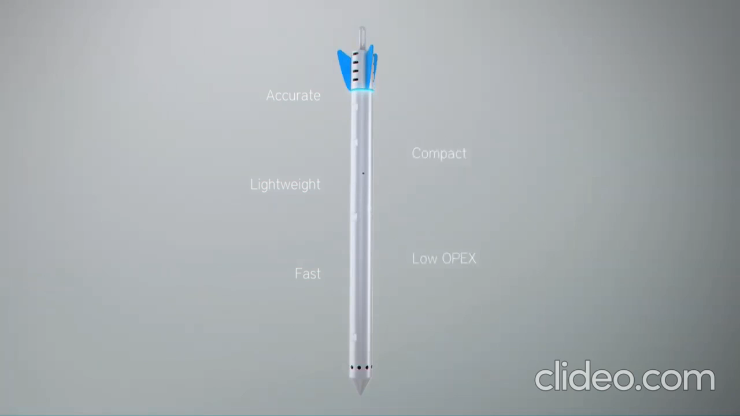
Free Fall cone test
FF-CPT is a simple, rapid and cost-effective method used for seabed characterization.
Uncertainties in data interpretation due to complexity in simulating the dynamic penetration process.
Numerical modelling issues
Large deformation
Complex soil behaviour during penetration (strain rate and strain sofening)
Soil-structure interaction during penetration
Effect of water
© dotOcean NV
Free Fall Cone Test
Notes:
Numerical and experimental understanding of penetration process is needed for :
Economical way to interpret soil properties
Corelation among different tests
Other Applications : impact driven piles, Vibratory driven piles, Jacked piles, etc...

Slide 5
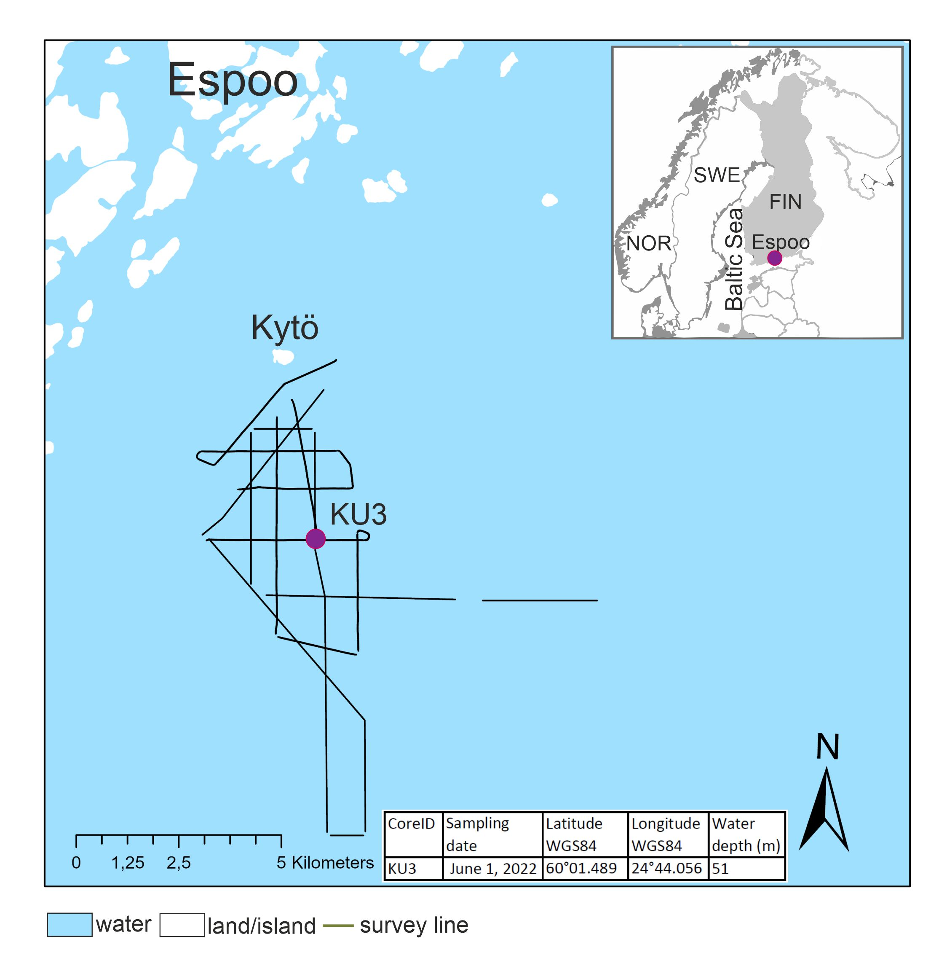
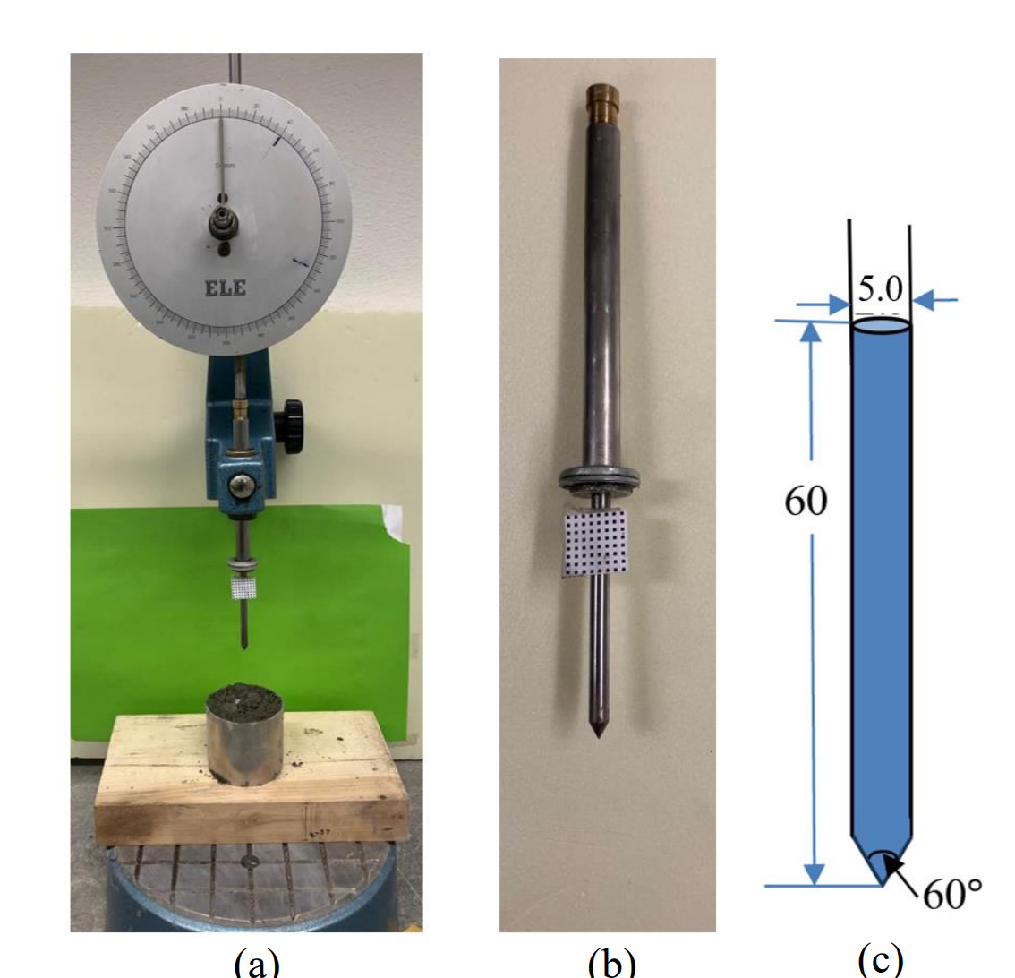
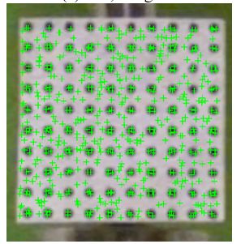
Laboratory Scale FF-CPT
Kytö, Finland
Tracker
Test set up

Slide 6
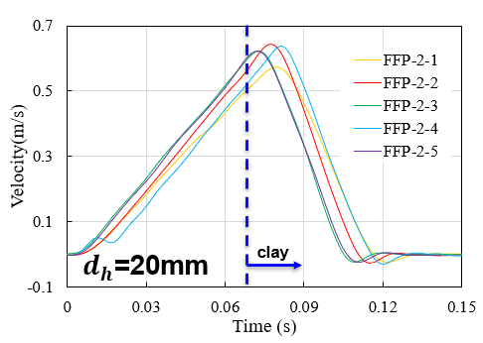
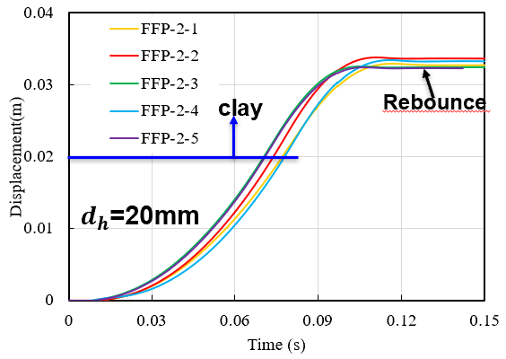
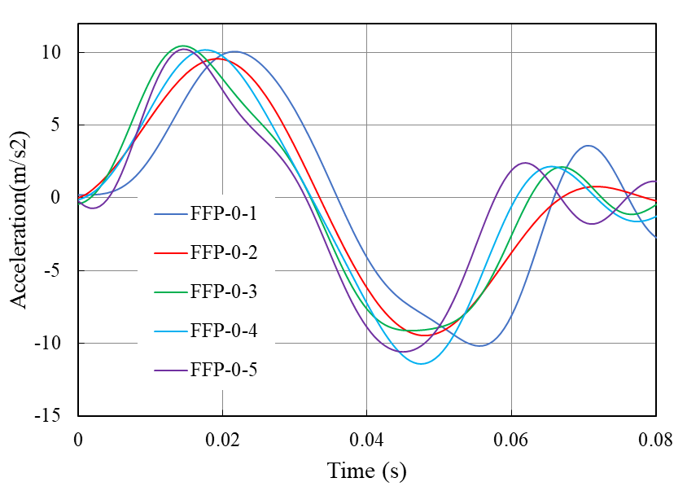
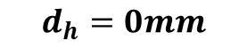
Experimental results
clay
$$d_{h}=0mm$$
Initial acceleration

Slide 7
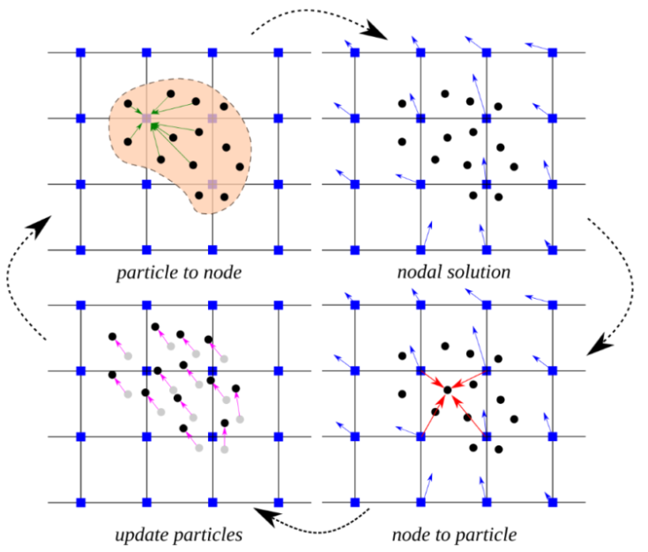
Material Point Method
Geometry discretised into material points, the material points carry all the material related data
Calculations done on a grid
In each time step, data from the material points needs to be transferred to the grid nodes, the calculations are done, and data is moved back to the material points
@https://www.cb-geo.com/research/mpm/#material-point-method

Slide 8
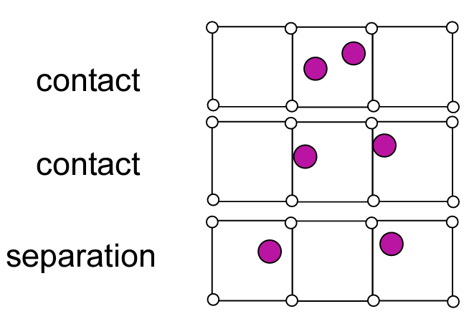
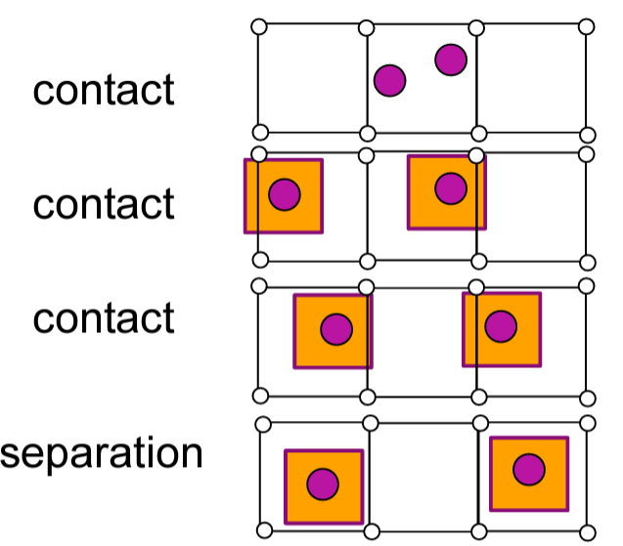
Classical MPM and GIMP
Classical MPM (No Domain)
Sulsky et al. (1994)
Cell crossing errors
Numerical instability
GIMP (with a Domain)
Bardenhagen & Kober (2004)
Domain: Square (uGIMP)
Domain is rectangle (cpGIMP)
Present analysis uses uGIMP

Slide 9
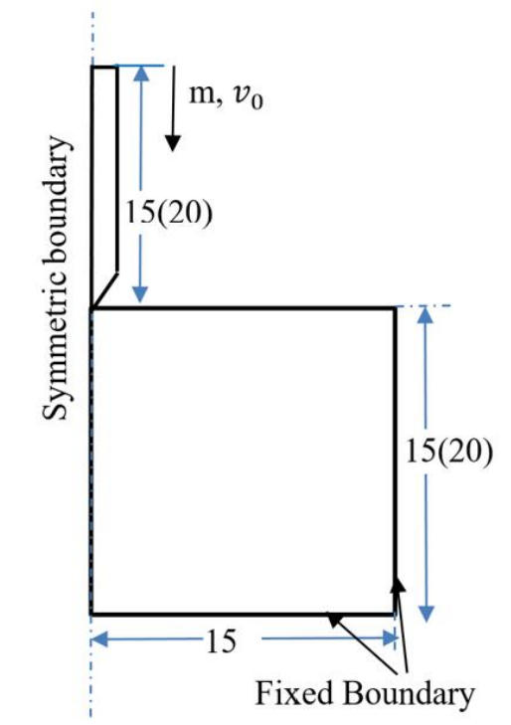

Numerical modelling of FF-CPT
The present analysis uses Explicit MPM as it is well-suited to solve dynamic large deformation problems.
We have used GIMP as encoded in Uintah open source software for the simulations.
http://uintah.utah.edu/
We have used extended Tresca material model to consider the strain rate and strain softening effects
Axisymmetric model used for MPM Analysis

Slide 10
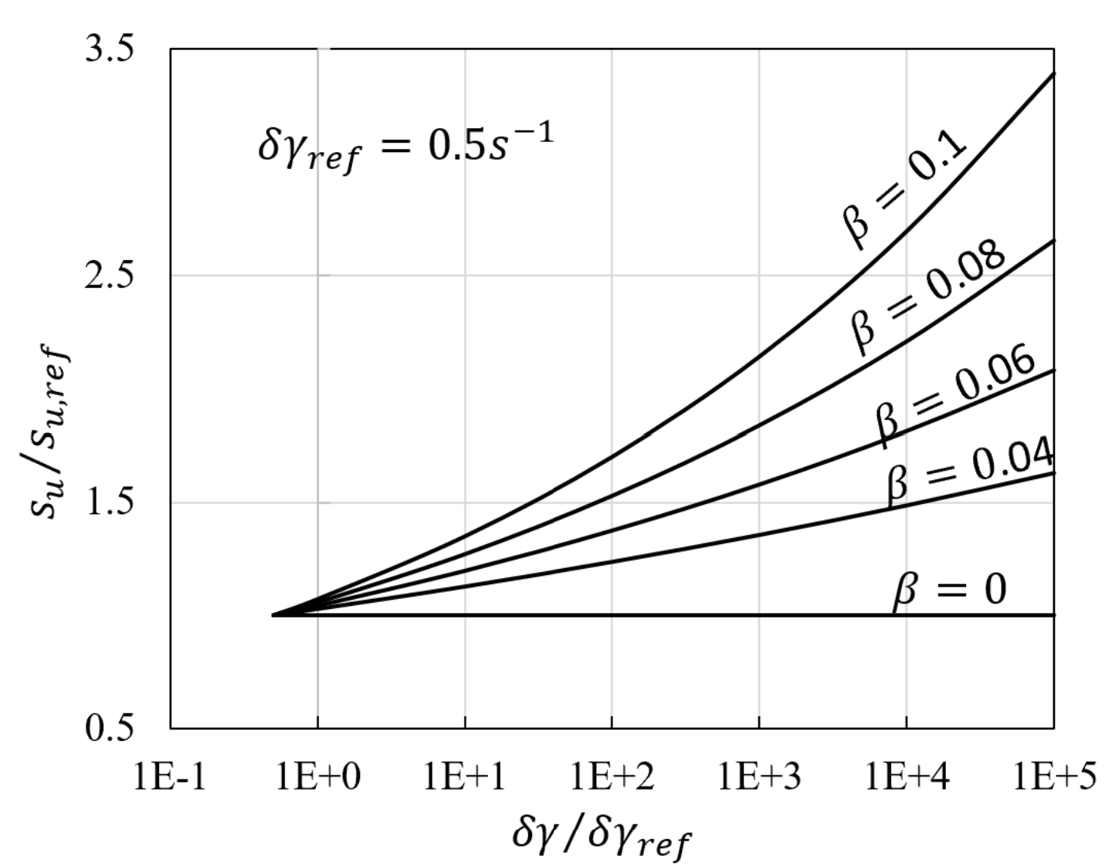
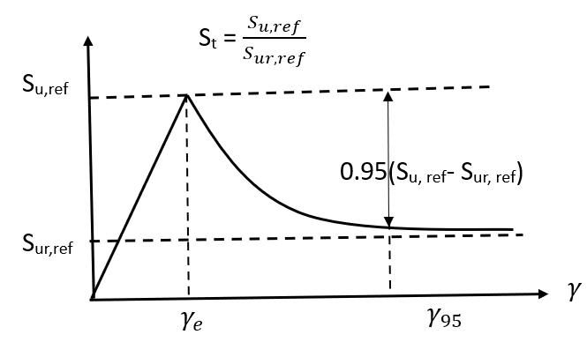
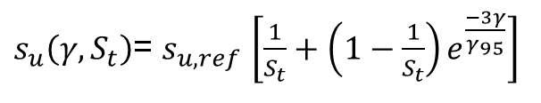
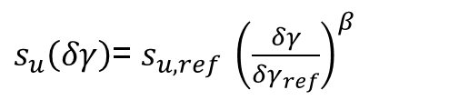
Effect of strain rate and strain softening
Effect of strain softening
Effect of strain rate
$s_{u}\left(δγ\right)$= $s_{u,ref} {\left(\frac{δγ}{δγ_{ref}}\right)}^{β}$
$s_{u}\left(γ,S_{t}\right)$= $s_{u,ref}$ $\left[\frac{1}{S_{t}}+\left(1−\frac{1}{S_{t}}\right)e^{\frac{−3γ}{γ_{95}}}\right]$

Slide 11
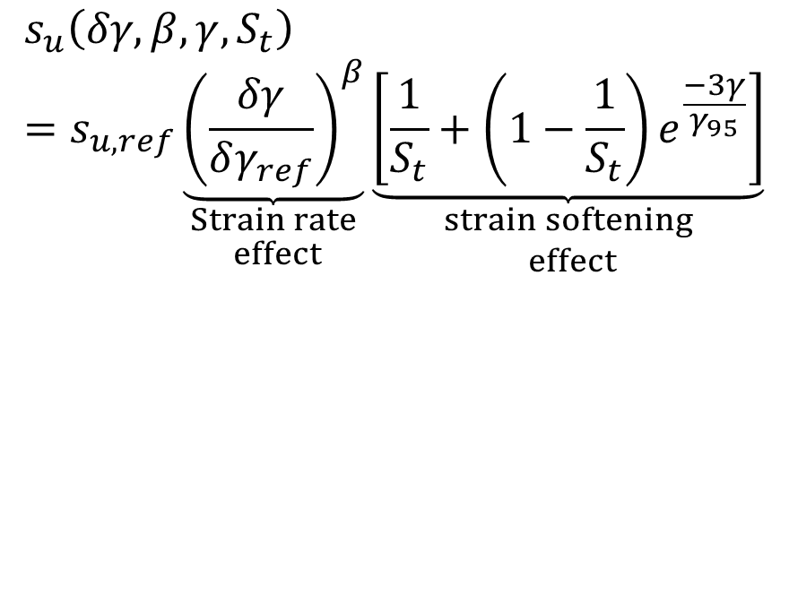
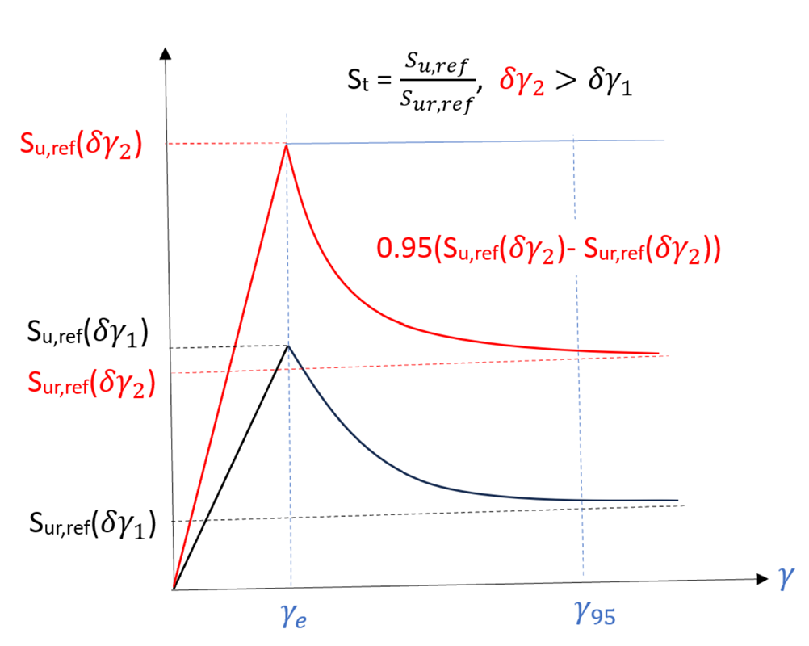

Slide 12
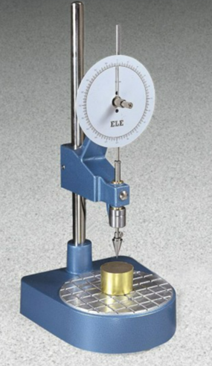
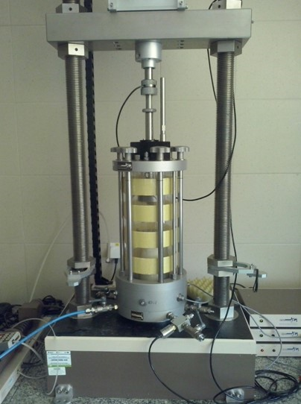
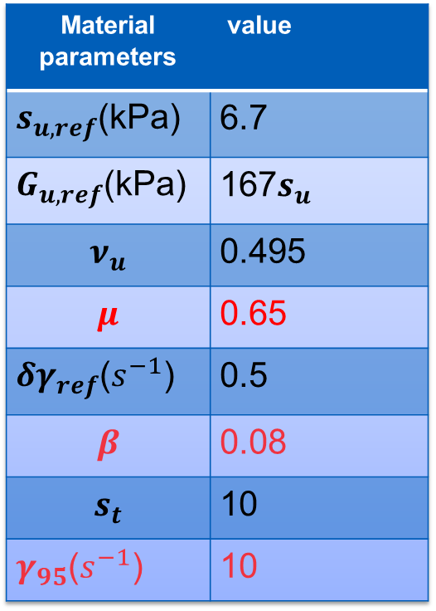
Selection of material parameters
Material parameters | value
$s_{u,ref}$(kPa) | 6.7
$G_{u,ref}$(kPa) | 167$s_{u}$
$$ν_{u}$$ | 0.495
$$μ$$ | 0.65
${δγ}_{ref}$($s^{−1}$) | 0.5
$$β$$ | 0.08
$$s_{t}$$ | 10
$γ_{95}$($s^{−1}$) | 10
@Wikipedia
Triaxial test
© ELE international
Free Fall Cone Test
We have numerically simulated FCT to see if our model is able to capture the dynamic penetration process or not and to take decision on the values of unknown material parameters.

Slide 13
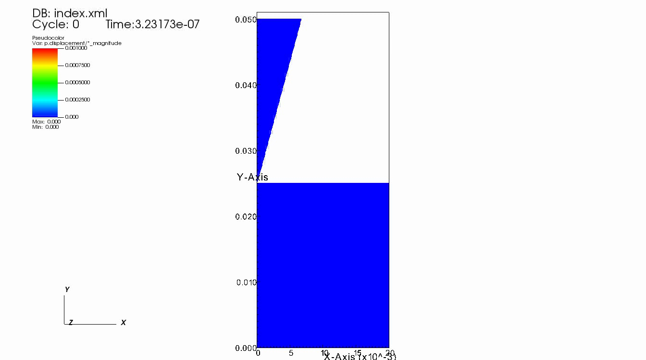
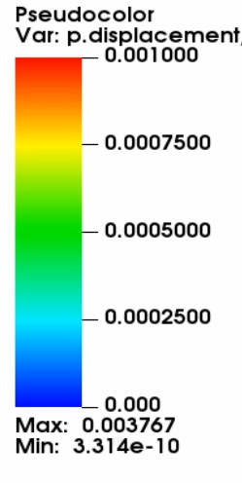
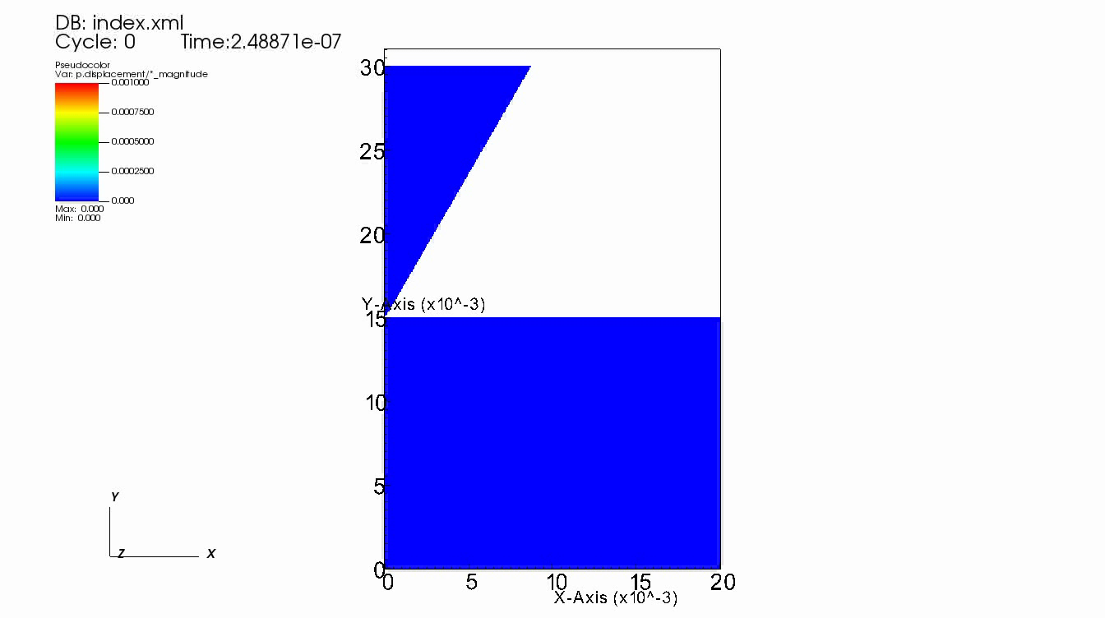
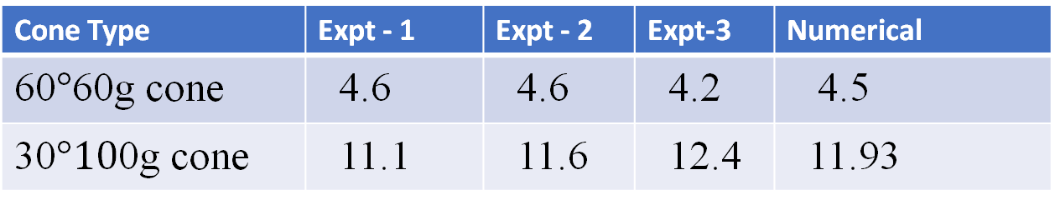


Numerical replication of fall cone experiment
The numerical simulations shows a good agreement with the experimental results.
The undrained shear strength values from FCT are close to triaxial test (We are doing lots of simulations.)
We have used same material parameters for FF-CPT simulations.
60$°,$60g cone
30$°, 10$0g cone
Cone Type | Expt - 1 | Expt - 2 | Expt-3 | Numerical
60$°$60g cone | 4.6 | 4.6 | 4.2 | 4.5
30$°10$0g cone | 11.1 | 11.6 | 12.4 | 11.93

Slide 14
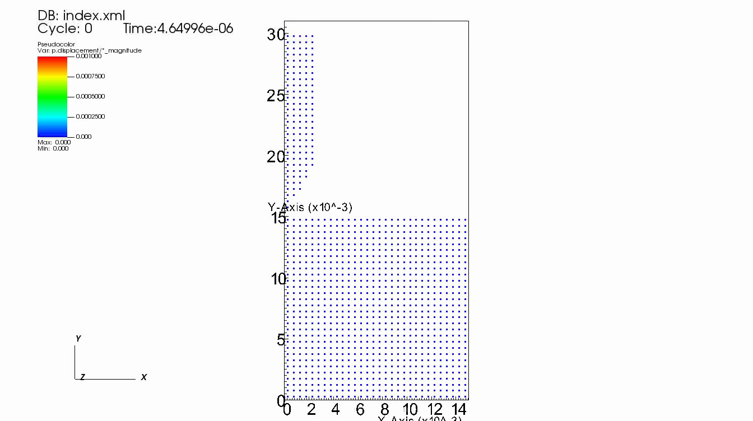
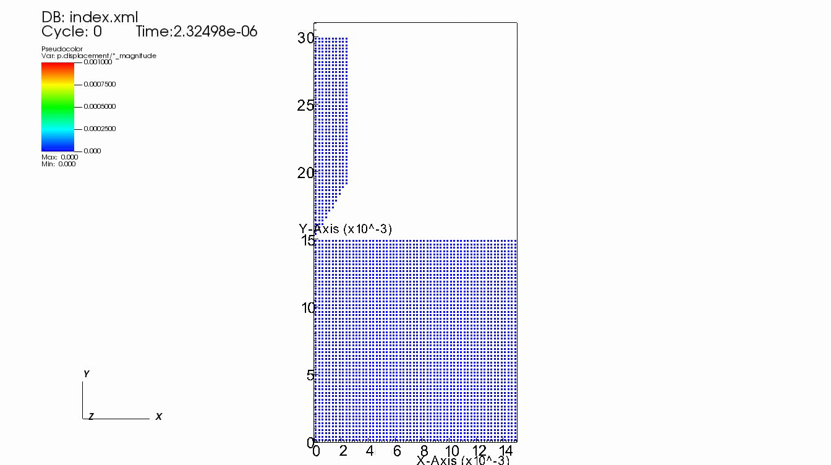
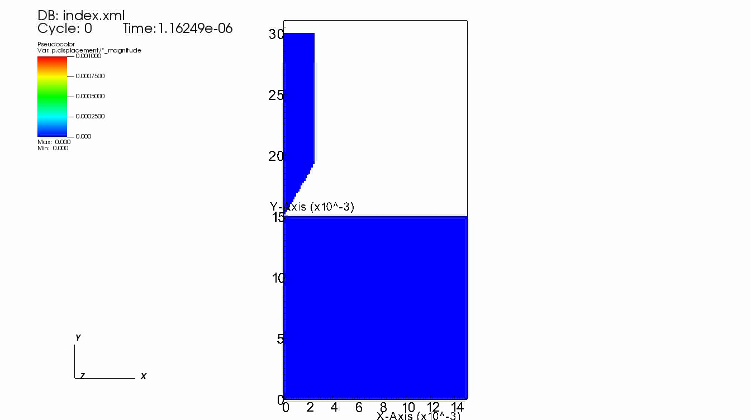


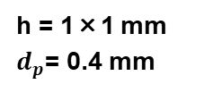
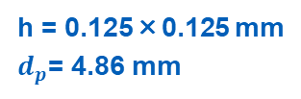
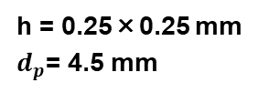
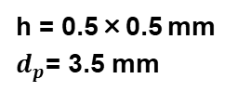
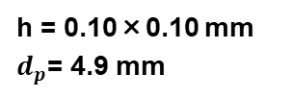
Influence of Grid Density
h = 1×1 mm
$d_{p}$= 0.4 mm
h = 0.5×0.5 mm
$d_{p}$= 3.5 mm
h = 0.25×0.25 mm
$d_{p}$= 4.5 mm
h = 0.125×0.125 mm
$d_{p}$= 4.86 mm
h = 0.10×0.10 mm
$d_{p}$= 4.9 mm
Used scaling law to reduce mesh dependency due to embedded shear band

Slide 15
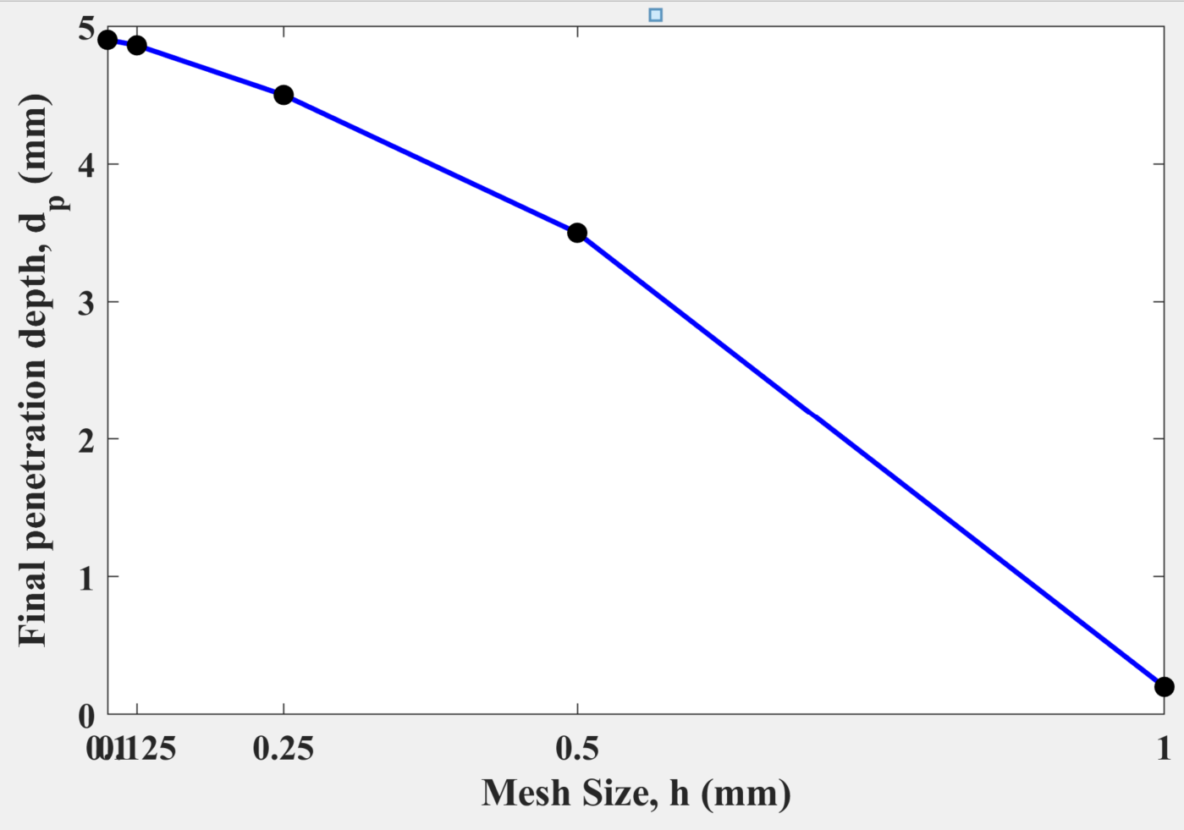
Influence of Grid Density

Slide 16
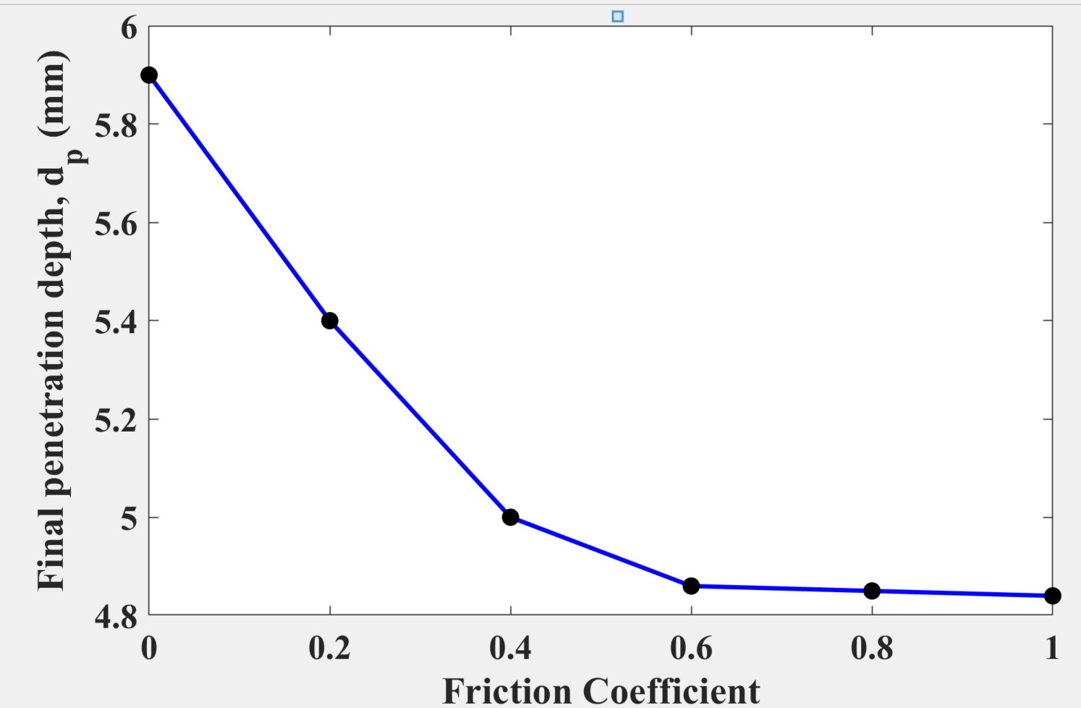
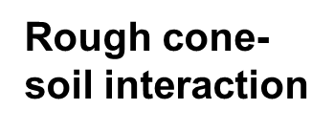
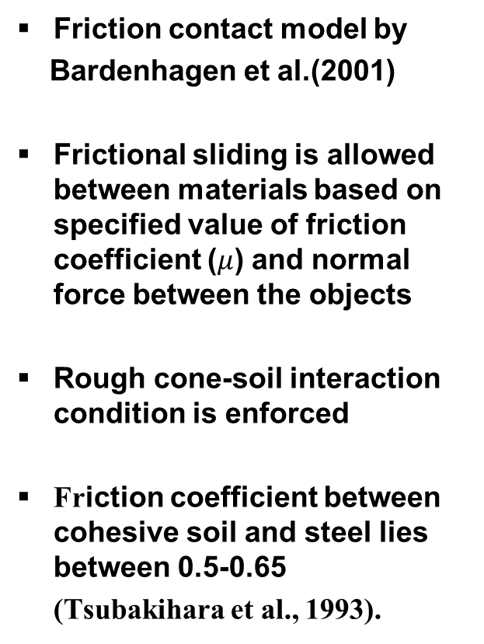
Cone-soil contact
cone
Friction contact model by
Bardenhagen et al.(2001)
Frictional sliding is allowed between materials based on specified value of friction coefficient ($μ$) and normal force between the objects
Rough cone-soil interaction condition is enforced
Friction coefficient between cohesive soil and steel lies between 0.5-0.65
(Tsubakihara et al., 1993).
soil
Friction contact model

Slide 17
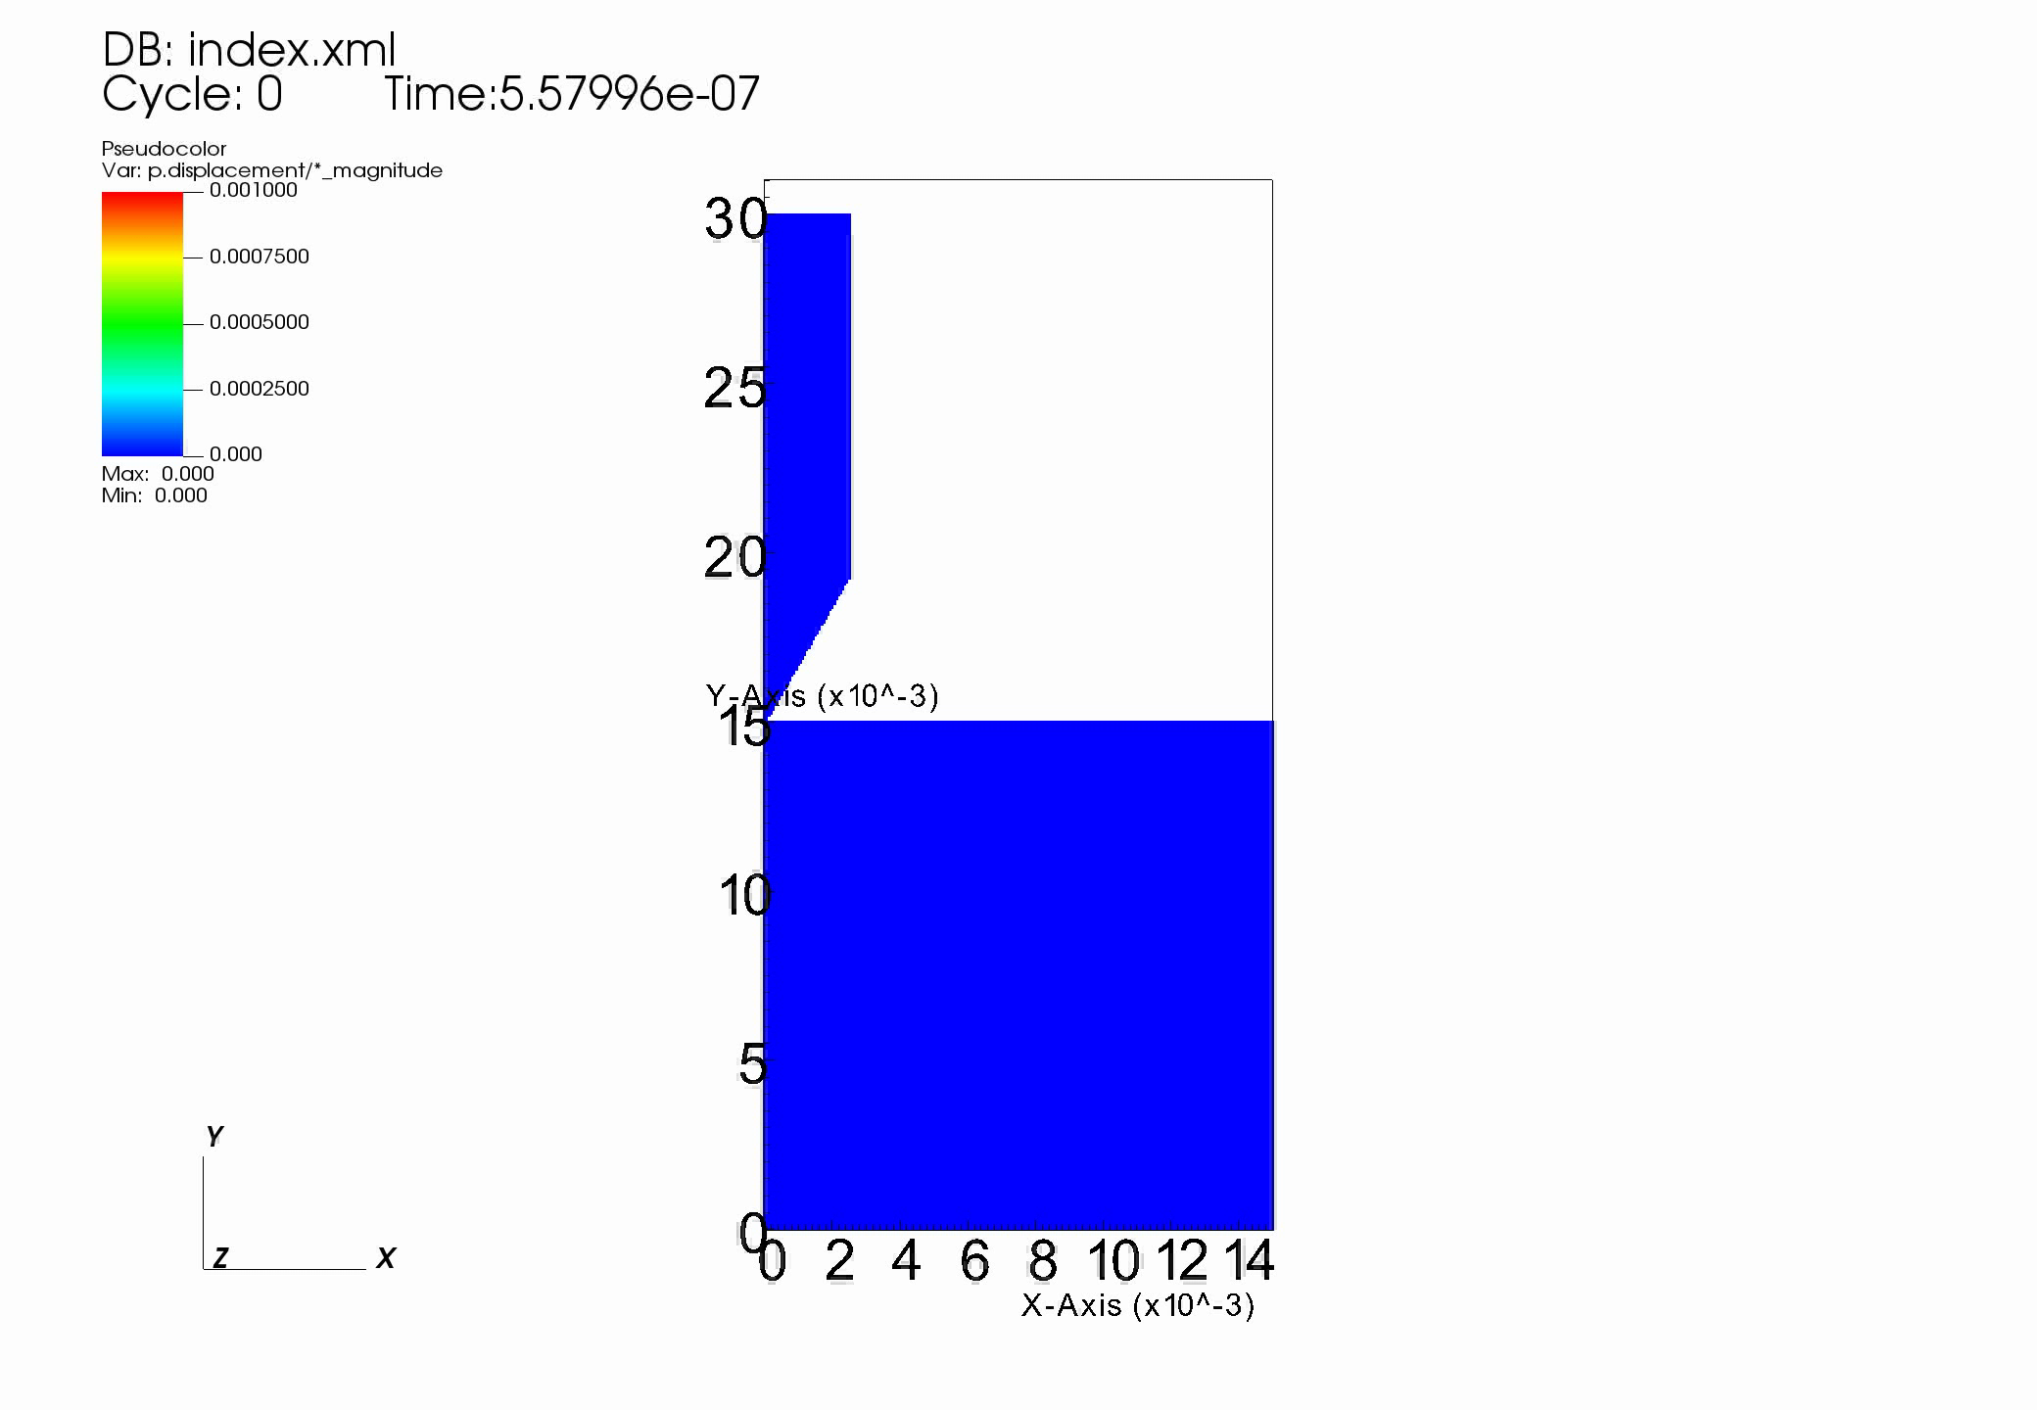
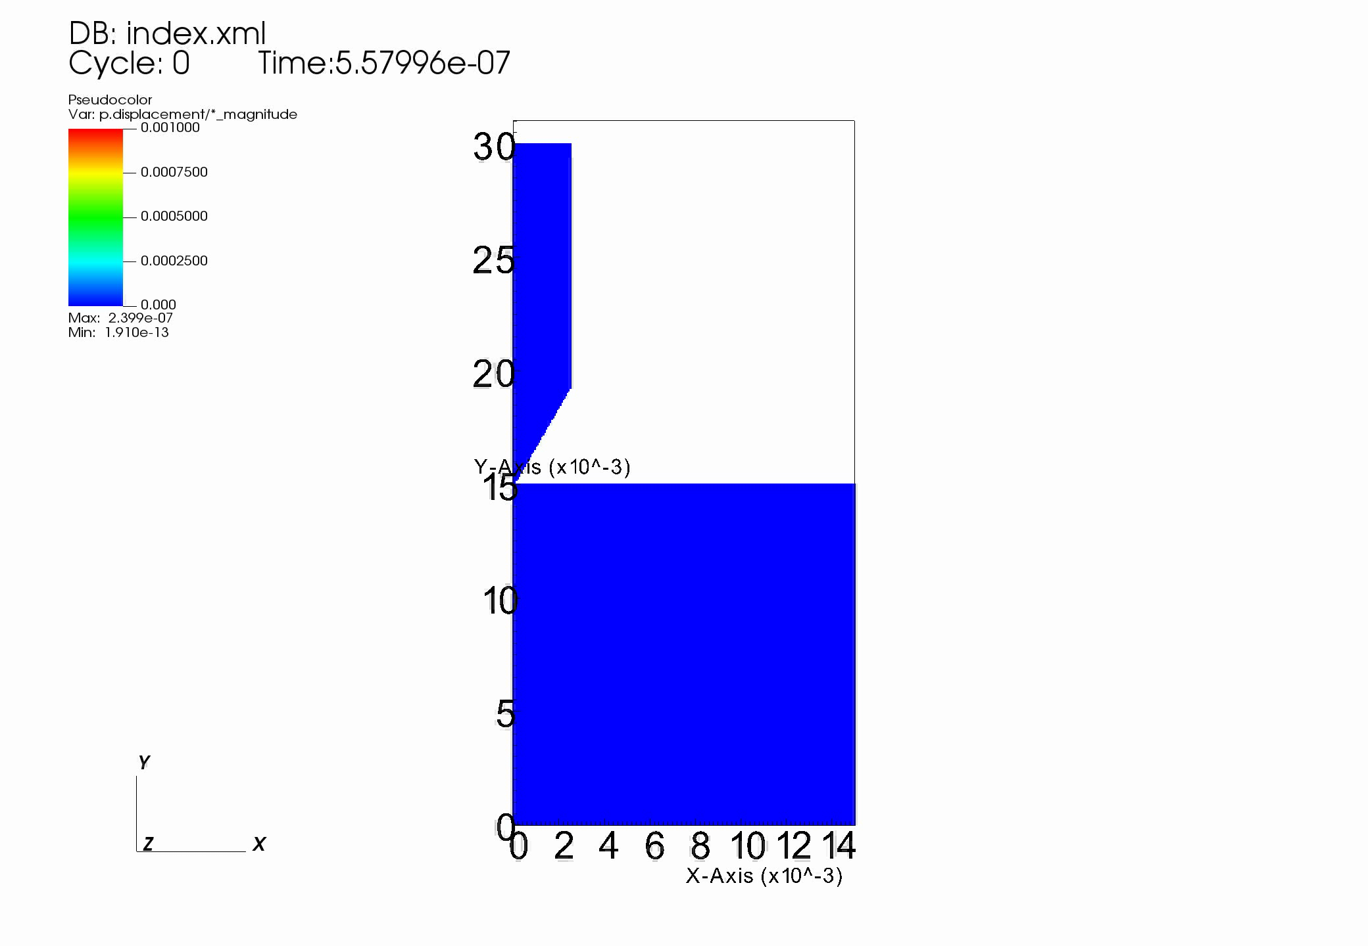
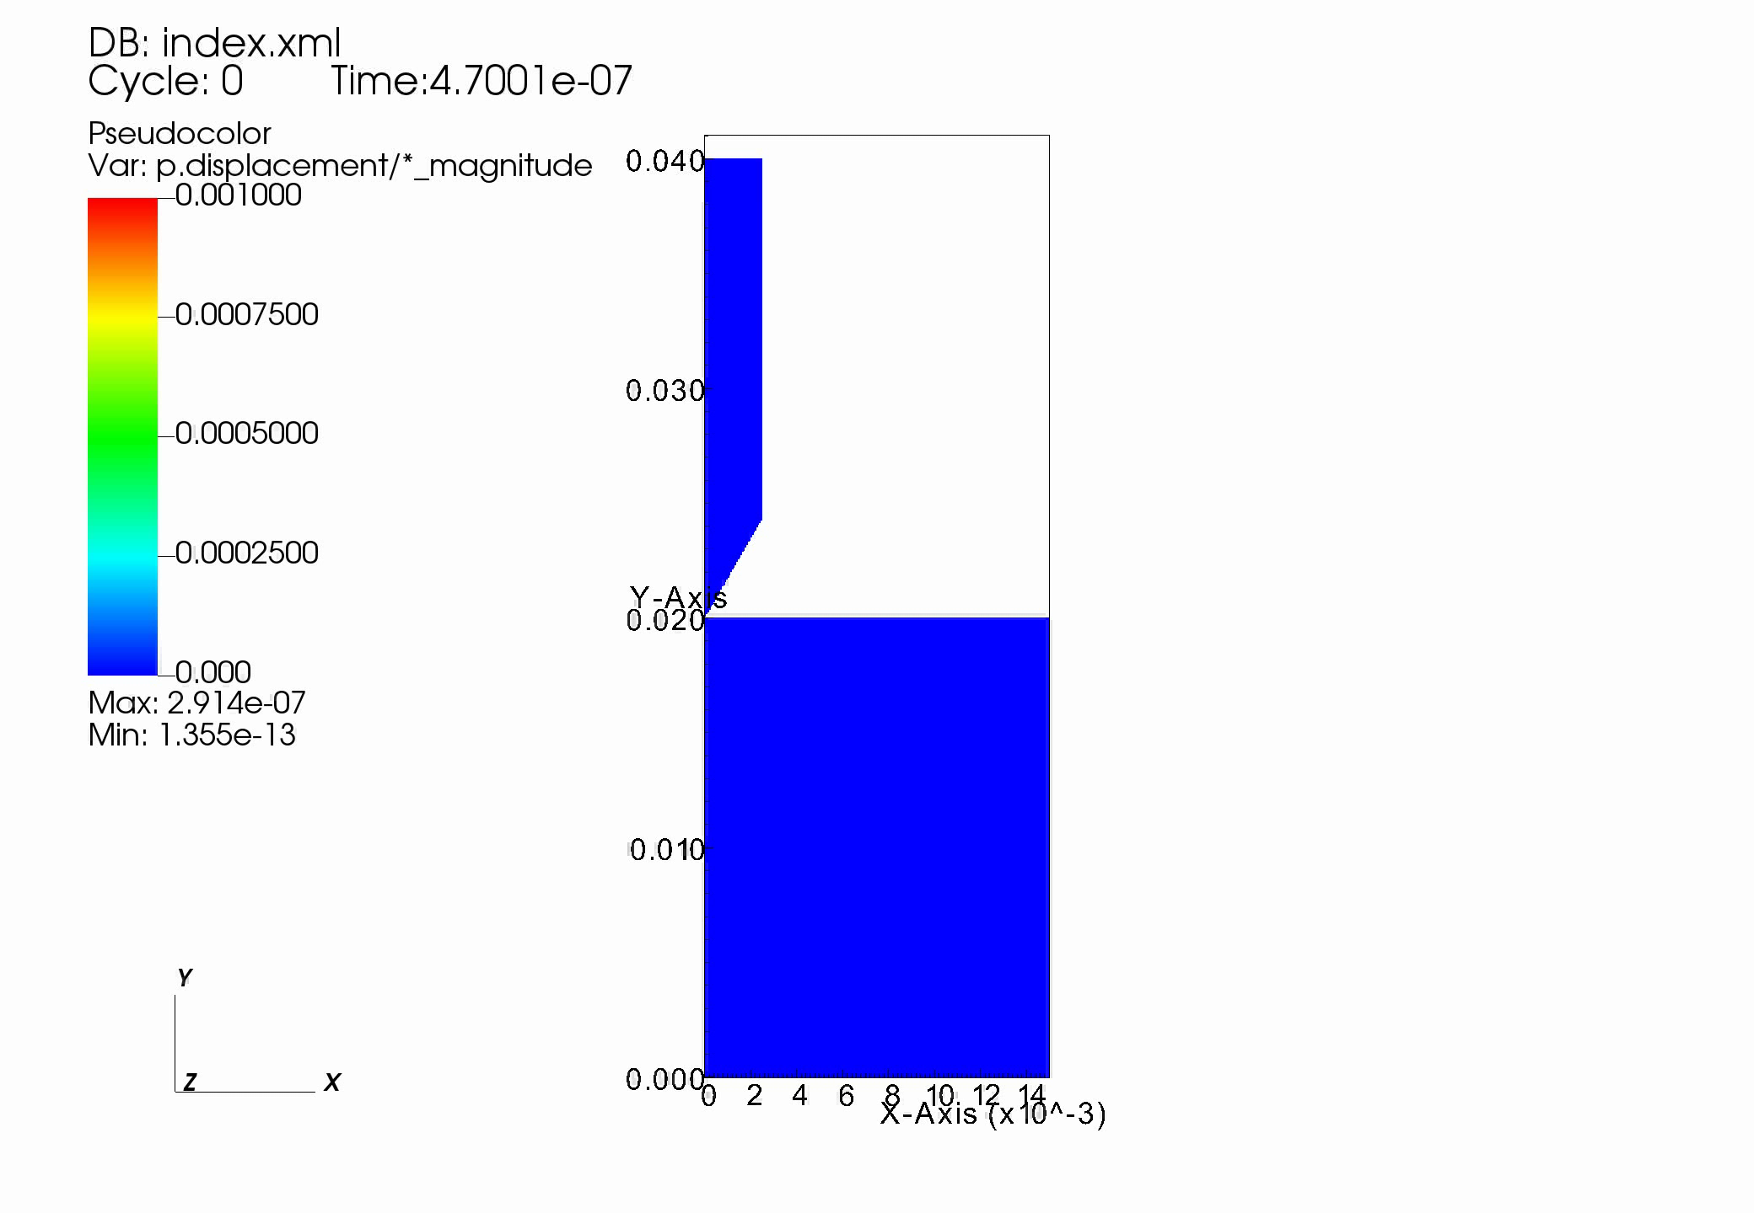
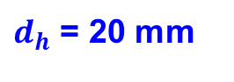
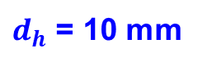
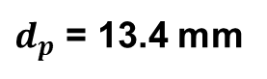
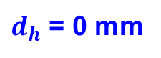
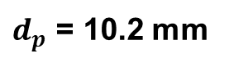
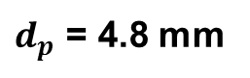
Numerical cone penetration process
$d_{h}$ = 0 mm
$d_{h}$ = 10 mm
$d_{h}$ = 20 mm
$d_{p}$ = 4.8 mm
$d_{p}$ = 10.2 mm
$d_{p}$ = 13.4 mm

Slide 18
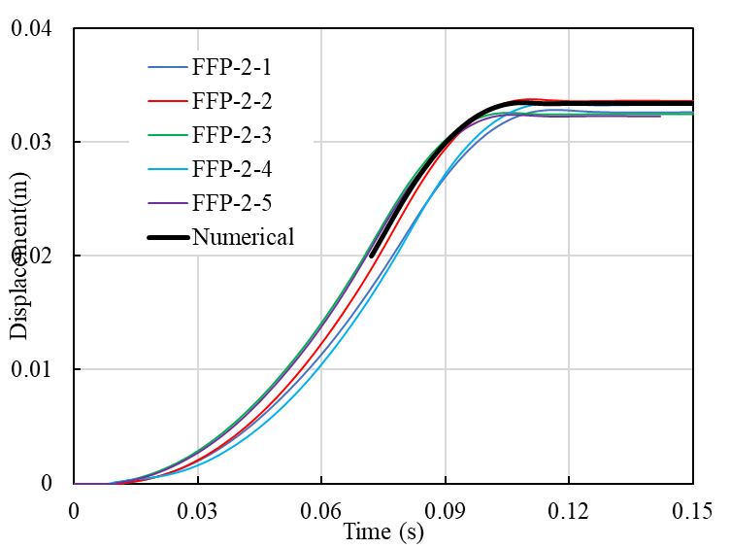







Numerical replication of FF-CPT
$d_{h}$ = 0 mm
$d_{h}$ =20 mm
$d_{h}$ = 0 mm
$d_{h}$ =20 mm
Oscillation

Slide 19








Effect of destructuration of clay
$${s_{u}}/{s_{u,ref}}$$
$d_{h}$ = 0 mm
$d_{h}$ = 10 mm
$d_{h}$ = 20 mm

Slide 20







Horizontal spread
5.5 mm
9.1 mm
11 mm
$d_{h}$ = 0 mm
$d_{h}$ = 10 mm
$d_{h}$ = 20 mm

Slide 21



Conclusion and outlook for future
Good replication of data : By using same material parameters as we have used to simulate fall cone tests, we are able to replicate laboratory scale FF-CP tests.
It seems that the used material model captures the most important aspects of the soil behaviour: destructuration and associated softening and strain rate dependency.
Minimum distance between the adjacent tests should be maintained.
The future research aim is to replicate free fall cone experiments on seabed numerically and investigate correlation between the data and soil properties
The Granular-MPM may be used to improve the acuuracy and efficiency of FF-CPT simulation

Slide 22
Thank you !!!

